Slide 1
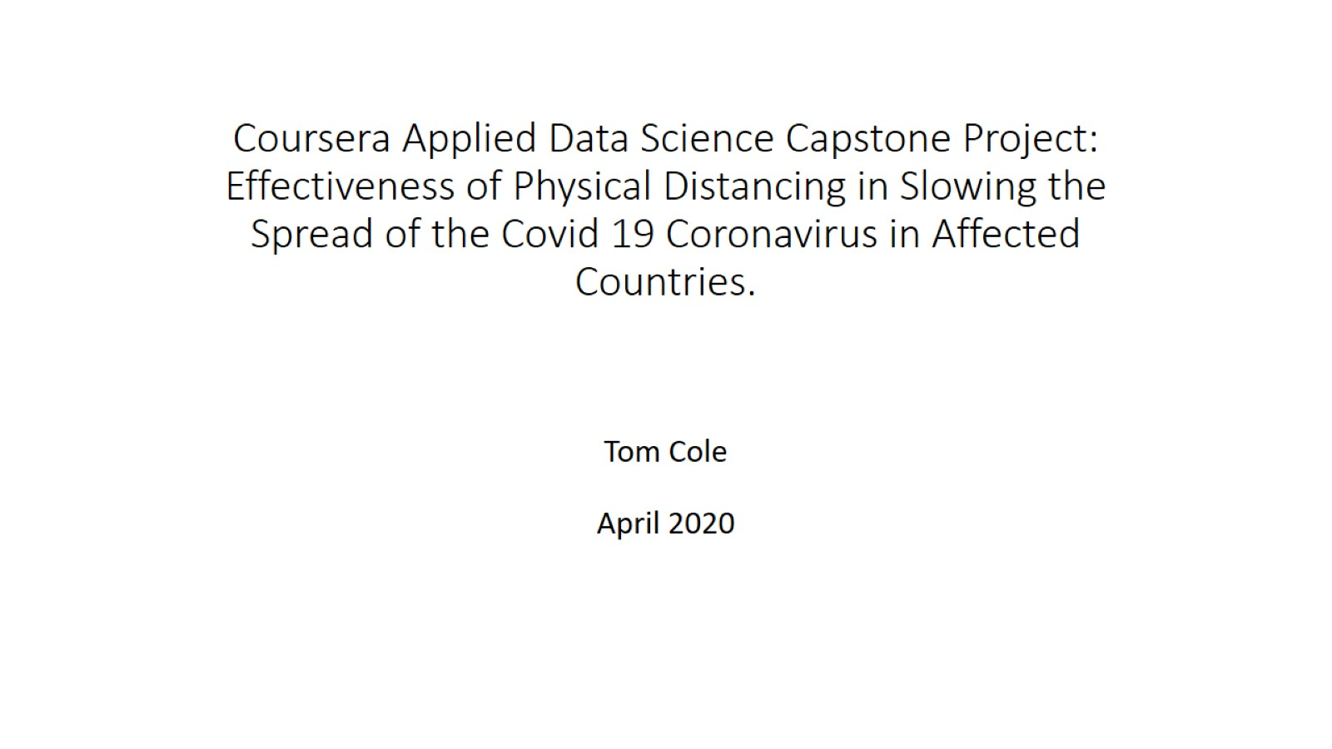
Coursera Applied Data Science Capstone Project: Effectiveness of Physical Distancing in Slowing the Spread of the Covid 19 Coronavirus in Affected Countries.

Slide 2
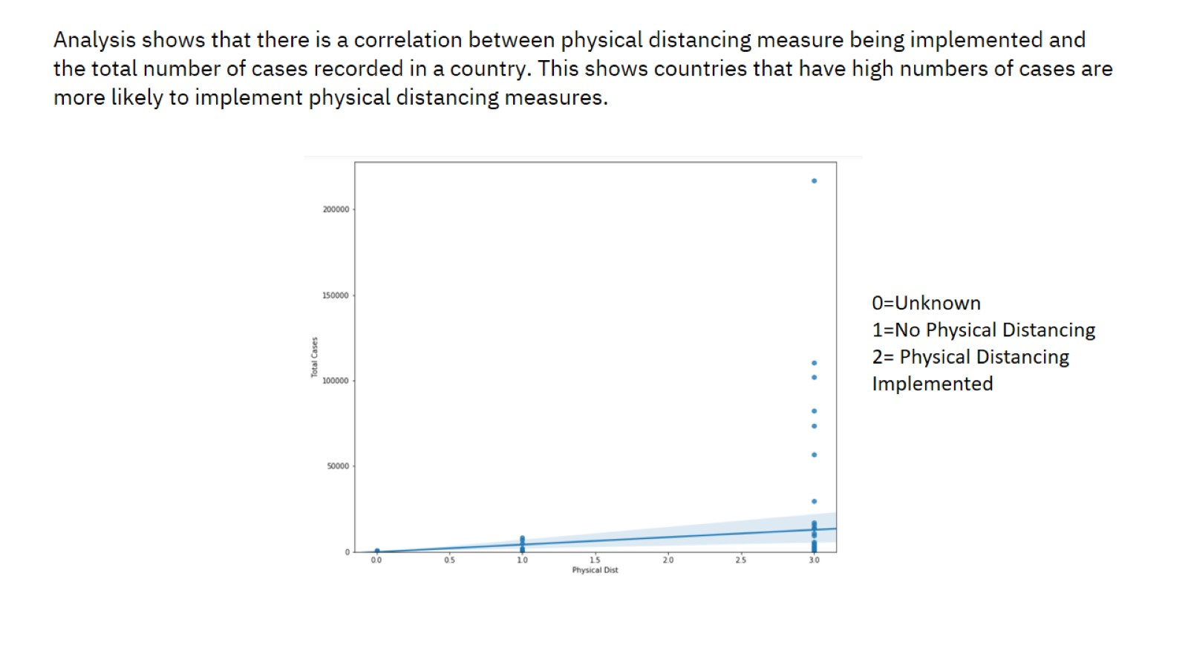

Slide 3
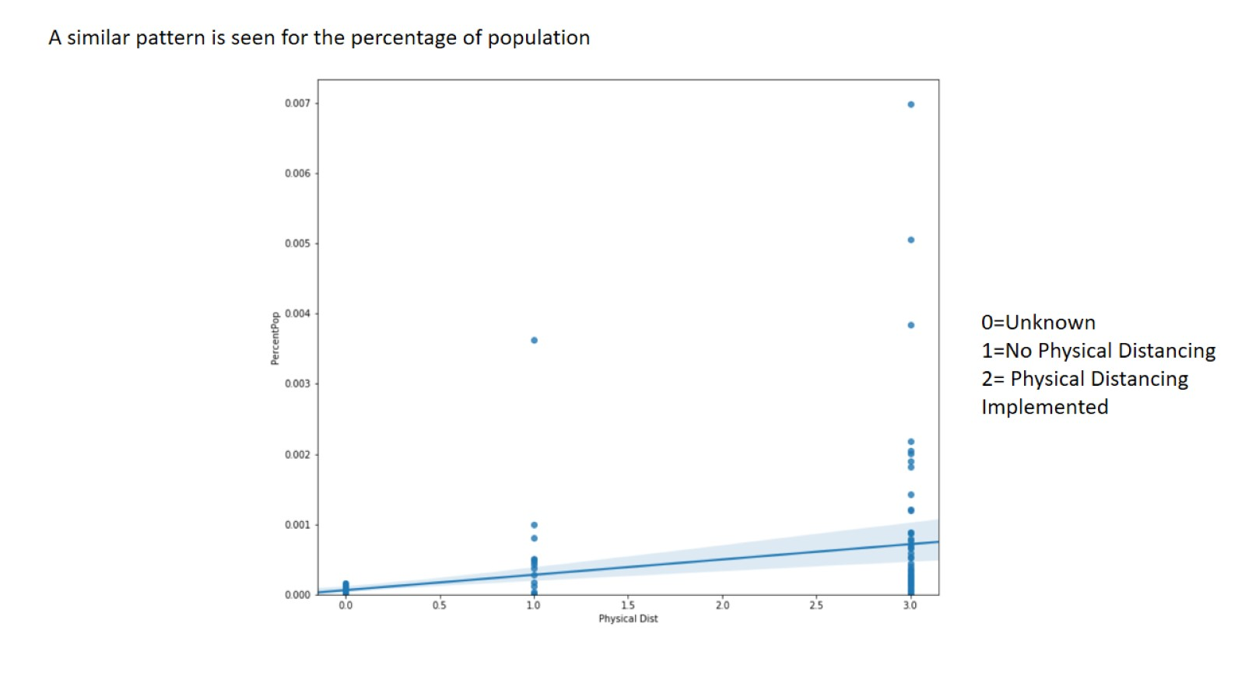

Slide 4
